Slide 1
Semifinalist Training Kick-Off
www.STCaustralia.org

Slide 2
How to Pitch at ‘The Finals’

Slide 3
Don’t Lie
(You would think this
goes without saying)
Too many entrepreneurs cross over the line between passionate enthusiasm & fraudulent misrepresentation
Common lies:
“Our projections are conservative”
“Boeing will sign our contract next week”
“Key employees will join us as soon as we get funded”
“Gartner says our market will be $50B by 2020”
“No one else is doing what we do”
“Several firms are doing due diligence”
“Patents make our business defensible”
“All we have to do is get 1% of the market”

Slide 4
What To Cover
In no particular order!
The Big Idea
Current Pain
Product
Opportunity
Industry Landscape
Market Fit/Competition
Business Model
Traction/Validation
Customer Acquisition
Regulatory & Reimbursement Strategy
IP
Who We Are
What’s the Future
Resources needed ($, expertise)
In 3 minutes, you cannot possibly answer all questions about your start-up.
But if you do it right, the audience (e.g. investor) will want to spend much more time with you to get those answers.
Notes:
Provide a complete picture without just avoiding what you don’t have good answers to. All needs to be covered, so what you don’t include as a slide, you’ll need to voice over. You’ve only got 3 minutes and 10 slides – don’t duplicate messages!

Slide 5
3
Depth Levels of Pitching Your Idea
5 seconds
30 seconds
3 minutes
Notes:
5 seconds: the most concise single sentence formulation of whatever your idea is.
Refine, refine, refine your thinking until you can say something intelligent and interesting in a short sentence. “My idea? It’s a way to make car engines twice as efficient, and 5 times as powerful.” This can be done for any idea: never allow yourself to believe your thing is so complicated and amazing that it’s impossible to explain in a sentence. If you were to use this excuse on me, I’d tell you it means you don’t have enough perspective on how your idea fits into the world.

Slide 6
Hook
A question or a statement that really entices the audience to stay with you for the full 3 minutes
Notes:
Example: Massoumi, CEO of ZocDoc, starts with a personal anecdote about how when he flew from Seattle to New York with a sinus infection, the pressure from the landing ruptured his eardrum. He compared the pain to what it might feel like if Mike Tyson bit off his ear. He logged into his insurance company's website to try to find a practitioner, but it wasn't easy. Some of the information was wrong, he couldn't easily gauge how good the doctors were on the list, and it took four days for him to find an appointment. After presenting the problem, Massoumi jumps into how ZocDoc could remedy the issue of booking dentist and doctor appointments instantly.
I'll also tell you what doesn't make for one--grandiose generalizations and huge top down numbers.
"We’re disrupting the medical apps industry, a $500 billion market."

Slide 7
Core Structure
1. The Opportunity
What problem or opportunity have you identified?
What is your solution to this problem or how do you plan to capture the opportunity?
Which customer pain will you alleviate?
What is your vision of the business and why do you care?
2: The Market
Which group of customers will you target?
How big is the potential market and how fast is it growing?
Who is your competition and why will your start-up prevail?
3. The Business Model (How Will You Make Money)
How much will you charge customers for your product and why will they pay the price?
What are the variable and fixed costs of your start-up and how much profit will it generate?
How many customers can you win over time and why do you think they will come on board?

Slide 8
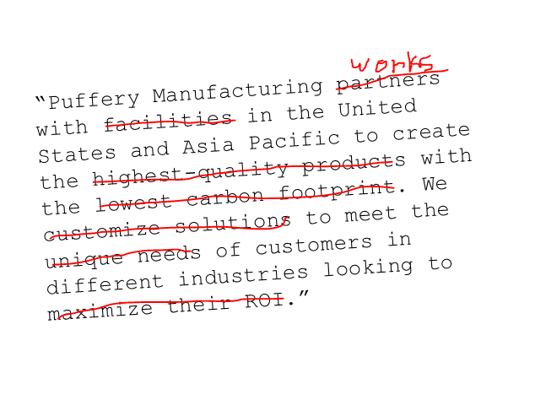
How to Say It
Don’t be salesy
Notes:
EVERYDAY LANGUAGE. Avoid words like “synergy”, “optimize”, “efficiency”, “ROI” and so on. These words SCREAM “sales pitch” and will have your panicked prospect looking for the exit signs.

Slide 9
Style Tips
Use a corporate colour palette
No font smaller than 30 point
Deck should be content light
<10 words/page is ideal
Show graphics, charts & screenshots that need little or no explanation
Use single-word bullets
Notes:
Deck should be simple/clear enough to explain itself and not need you to present it
When presenting, have additional info/insight to share with each slide = your “added value”

Slide 10
Style Tips
Check for typos/math errors or internal inconsistencies
Use consistent formatting: caps vs lowercase, colours, font type, font size, spacing
Font type: easy to read – no odd looking letters
Don’t use dashes as bullets: they look negative. Use other styled bullets

Slide 11
Giving a Visual Presentation
Yes!
apple
No!
Notes:
Avoid text, especially if you’re just going to regurgitate it back to them. The audience isn’t stupid, they can read. But do you really want them reading your slides instead of paying attention to you?

Slide 12
KILLER
PRESENTATIONS
Are NOT Documents for Live Reading
Notes:
People aren’t there to see you read aloud.

Slide 13
1
idea per slide

Slide 14
