Slide 1
STRENGTH BY
NUMBERS

Slide 2
IF YOU'RE NOT MEASURING
YOU'RE GUESSING
STEPHEN KING,
SPORTS MEDICINE AUSTRALIA

Slide 3
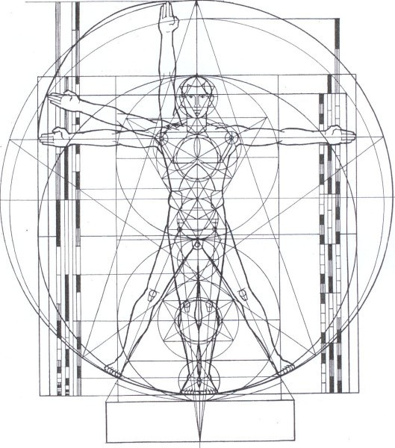
QUANTIFY DIGITIZE MONITOR

Slide 4
STRENGTH BY NUMBERS
INTEGRATED SYSTEM OF WIRELESS SENSORS

Slide 5
$1.5 billion
USD PER YEAR
$35 billion
USD PER YEAR
LARGE GLOBAL MARKET

Slide 6
GROWTH POTENTIAL
BIG DATA
MACHINE LEARNING
ANALYTICS
HOME GYM TELEMED
PHYSIO
PHASE 1
PHASE 2
PHASE 3

Slide 7
ENTREPRENEURS
ENGINEERS
PHYSIOTHERAPISTS

Slide 8
PROTOTYPES
TESTING
CONFIRMED
FEASIBILITY
REGULATORY
COMPETITIVE LANDSCAPE

Slide 9
HELP BRING PHYSIOTHERAPY
INTO THE DIGITAL AGE

Slide 10
IF YOU'RE NOT MEASURING
YOU'RE GUESSING
STEPHEN KING,
SPORTS MEDICINE AUSTRALIA

